Slide 1





International Course on MASSIVE Data Analysis
Genome‐wide Association Studies Pipeline (GWASpi): a desktop application for
genome‐wide SNP analysis and management
Arcadi Navarro & Fernando Muñiz
CIPS, March the 23rd 2011

Slide 2


From where?

Slide 3

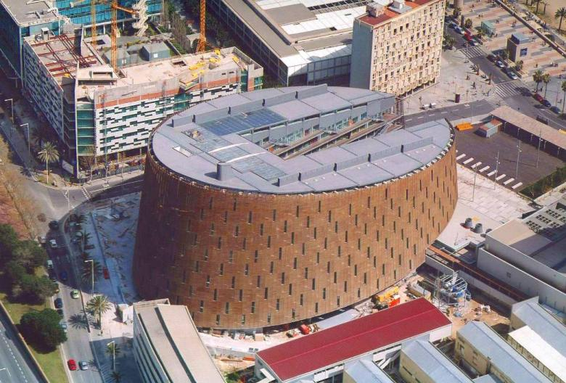
From where?

Slide 4
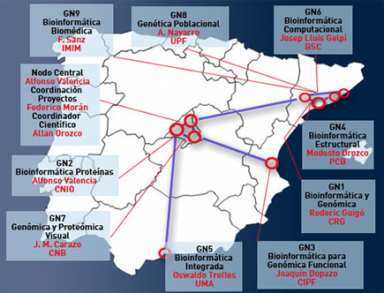
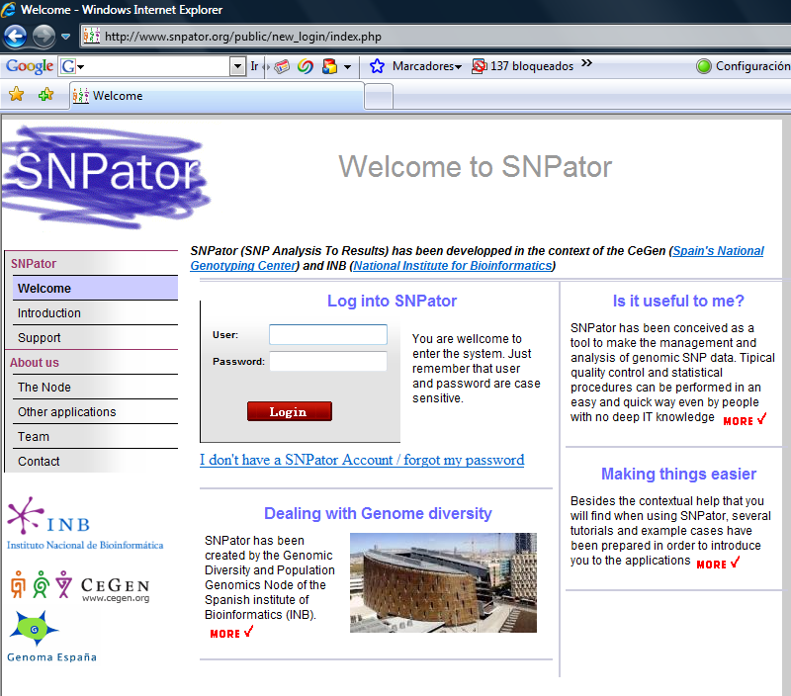
Our CeGen-INB Role
The INB (National Bioinfomatics Insitute)
Tools and algorithms in the context of the INB. More than 600 projects serviced

Slide 5
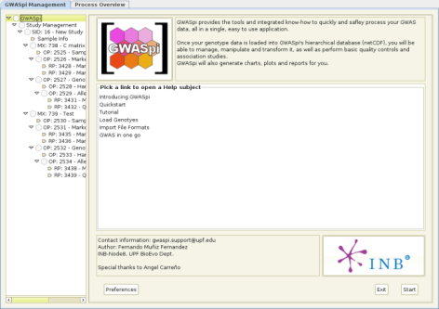
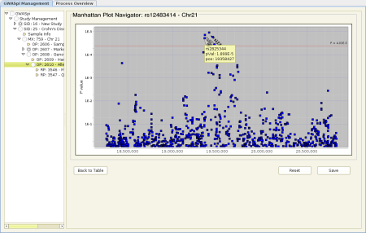
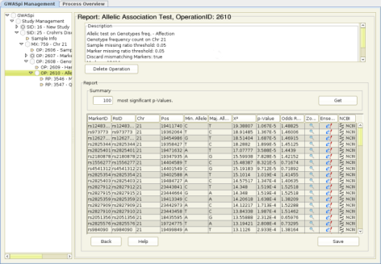
GWASpi
Genome-Wide Association Studies Pipeline
A desktop application for genome-wide SNP analysis and management featuring state-of-the-art storage technologies

Slide 6
Why Genomes? Disease
Monogenic diseases
Complex diseases

Slide 7
Why Genomes? Genome Variation
Sequence
Single base-pair changes – point mutations (SNPs, Single Nucleotide Polymorphisms: >3Mb diff between any two genomes)
Small insertions/deletions– frameshift, microsatellite, minisatellite
Mobile elements—retroelement insertions (300bp -10 kb in size)
Large-scale genomic variation (>10 kb)
  Large-scale Deletions and Amplifications
  Segmental Duplications (SDs)
  Copy Number Variations (CNVs)
Chromosomal variation—translocations, inversions, fusions.
Cytogenetics

Slide 8
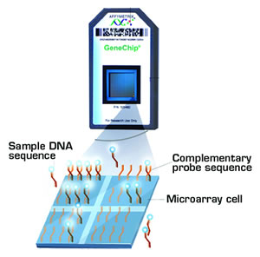
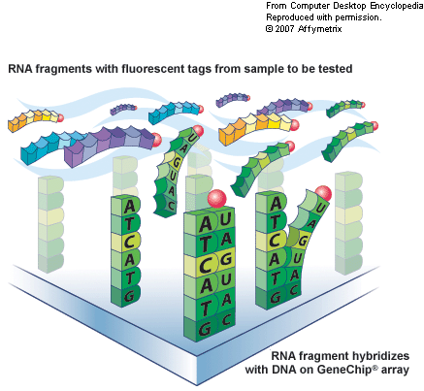
Why Genomes? SNP Arrays
Arrays contain SNPs… plus some other goodies

Slide 9
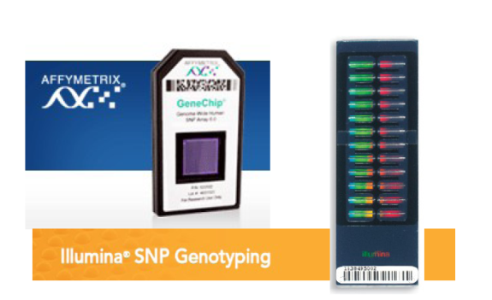
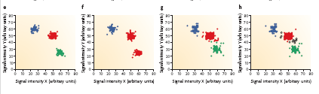
Why Genomes? Calling Genotypes
GATTTAGATCGCGATAGAG
GATTTAGATCTCGATAGAG

Slide 10


Why Genomes? Association Studies
CASES:
CONTROLS:
AB
BB
AA
AB
AB
BB
BB
AB
BB
BB
BB
AB
BB
BB
AB
AB
AA
BB
BB
BB
AB
AA
BB
AB
BB
AB
AA
BB
BB
AB
BB
AB
BB
BB
BB
The most popular design for studying genetic association between a disease and a marker is to compare a set of cases with a set of controls (case-control design) collected from the same population. It is important to collect data on exposure to potential non-genetic (environmental) risk factors

Slide 11
Why Genomes? Association Studies
The association strength between a marker and the disease status is usually measured by an odds-ratio (OR)
Risk factor
n_{11 *} n₂₂
Odds-ratio (OR) =
Yes No
Cases n₁₁ n₁₂ n_{1.}
Controls n₂₁ n₂₂ n_{2.}
n_{.1} n_{.2} n..
n_{21*} n₁₂
OR=1
OR>1
OR<1
No difference in risk of exposed
Increased risk of exposed to the risk factor
Lower risk (“protective”) of exposed to the risk factor
The 95% confidence interval (CI) of OR contains both information on “strength” and “significance”
When the sample size is increased, typically the p-value can become even more significant, whereas OR usually stays the same (but 95% CI of OR becomes more narrow).

Slide 12
Why Genomes? Association Studies
Similar for SNPs (both alleles and genotypes)
Allele-based test :
Alleles
A a
Cases n_{A} n_{a} 2N
Controls m_{A} m_{a} 2M
t_{A} t_{a} 2(N+M)
  Pearson’s χ² test on 2×2 table:
χ₁² = Σ (O-E)²
n_{A *} m_{a}
Odds-ratio (OR) =
E
m_{A*} n_{a}

Slide 13
Why Genomes? Association Studies
Similar for SNPs (both alleles and genotypes)
Genotype-based test :
Genotypes
AA Aa aa
Cases n_{AA} n_{Aa} n_{aa} N
Controls m_{AA} m_{Aa} m_{aa} M
t_{AA} t_{Aa} t_{aa} N+M
  Pearson’s χ² test on 2×3 table:
χ₂² = Σ (O-E)²
E

Slide 14
Why Genomes? Performing AEs
SNPator (SNP Analysis TO Results)
An application for data handling and analysis
http://www.snpator.org/

Slide 15
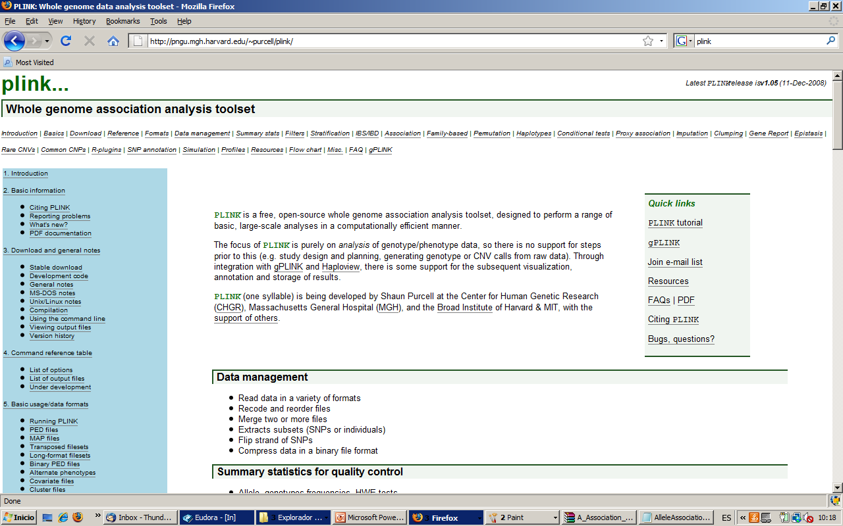
Why Genomes? Performing AEs
PLINK

Slide 16
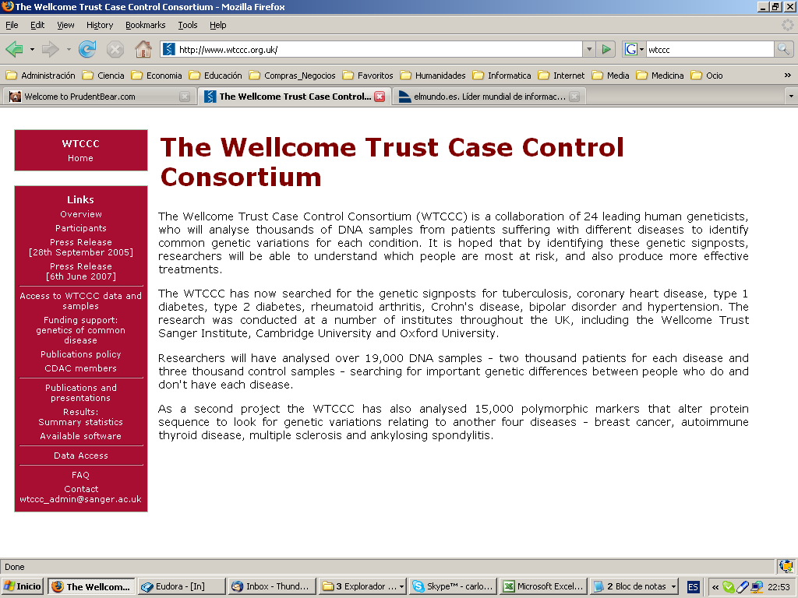
Why Genomes? GWAS

Slide 17
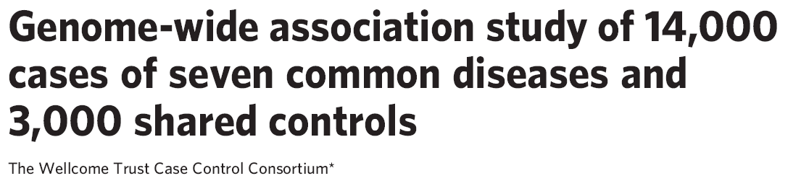
WTCCC
The Wellcome Trust Case Control Consortium (WTCCC) is a UK wide collaboration of over 50 research groups (clinical, experimental and analytical) aiming for a better understanding of common human diseases.
A combined genome wide association (GWA) study of 7 common diseases with British samples.

Slide 18

WTCCC
2,000 cases from each of seven diseases:
  bipolar disorder (BD)
  coronary artery disease (CAD)
  Crohn’s disease (CD)
  hypertension (HT)
  rheumatoid arthritis (RA)
  type 1 diabetes (T1D)
  type 2 diabetes (T2D)

Slide 19
WTCCC
3,000 shared controls
  1,500 representative samples from the 1958 British Birth Cohort
  1,500 are blood donors recruited by the three national UK Blood Services
Affymetrix 500K chip

Slide 20
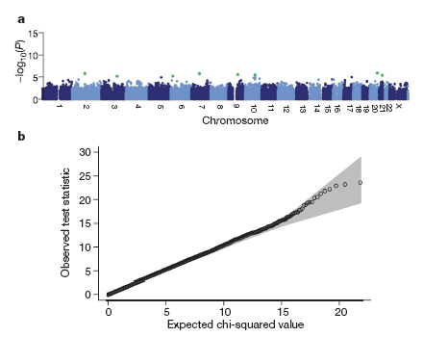
WTCCC
Genome-wide scan for allele frequency differences between controls.

Slide 21
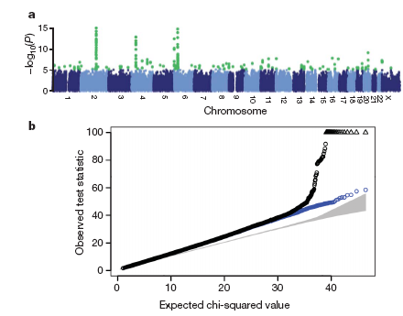
WTCCC
Genome-wide picture of geographic variation.

Slide 22
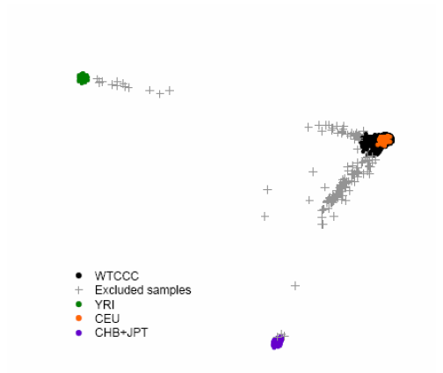
A posteriori control of stratification (brute force!!)
  The WTCCC case: non-fitting subjects just removed

Slide 23
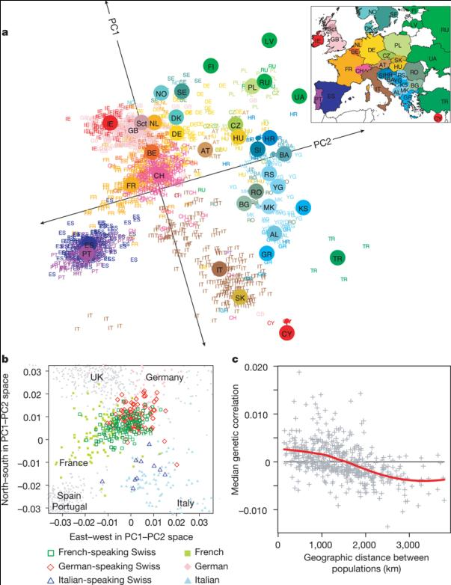
A posteriori control of stratification (brute force!!)
  The Importance of Stratification
Population structure within Europe.
November et al Nature 456, 98-101 (6 November 2008)

Slide 24
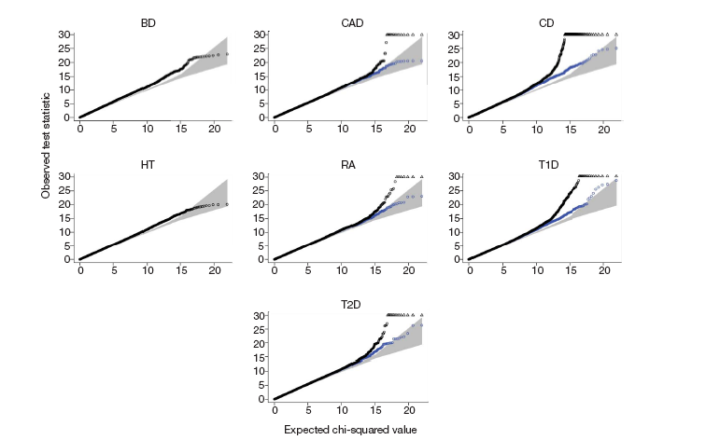

Slide 25
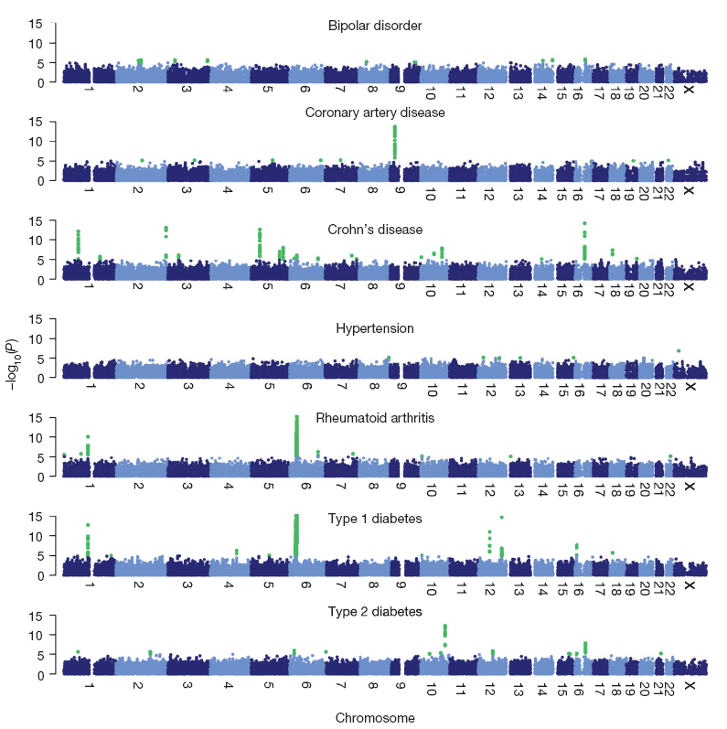
WTCCC

Slide 26
WTCCC

Slide 27
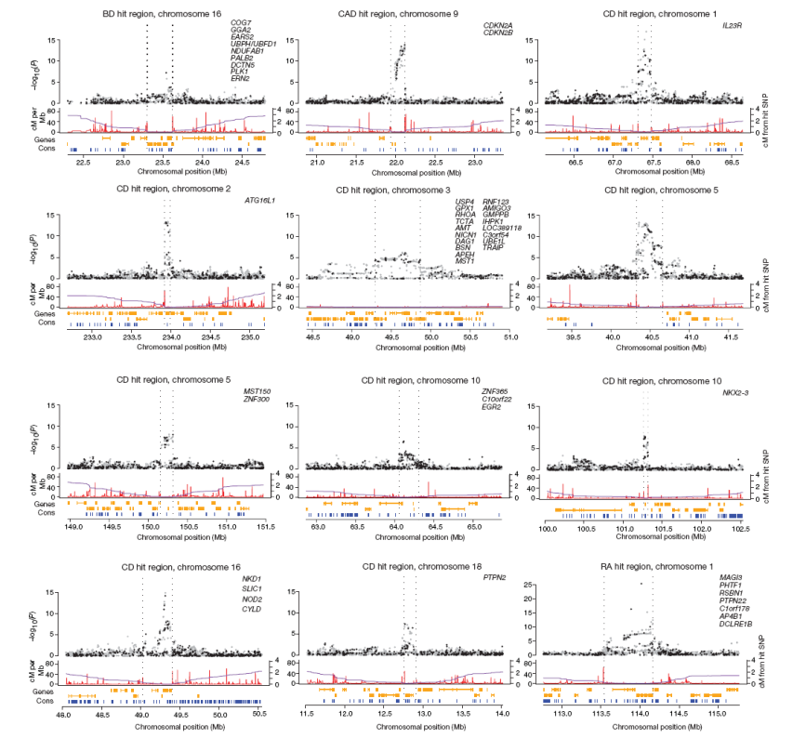
WTCCC

Slide 28
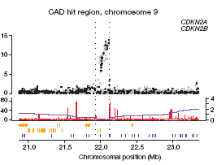


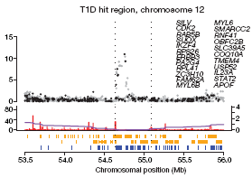
WTCCC

Slide 29
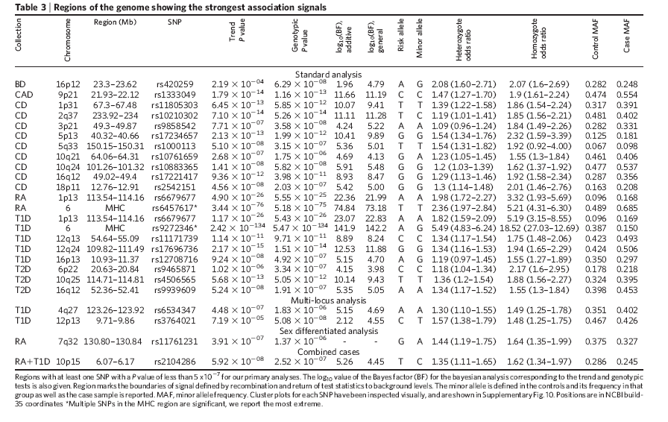

Slide 30
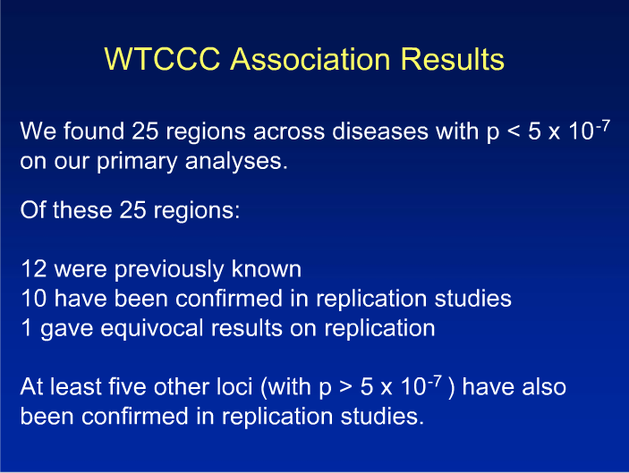
WTCCC

Slide 31
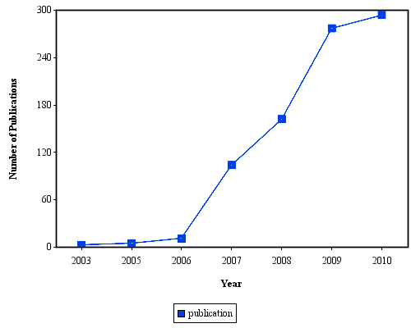
GWAS, a popular analysis approach
Number of GWAS studies published yearly has increased
  from 3 in 2003
  to 277 in 2009
  384 in 2010
(Human Genome Epidemiology Network)

Slide 32
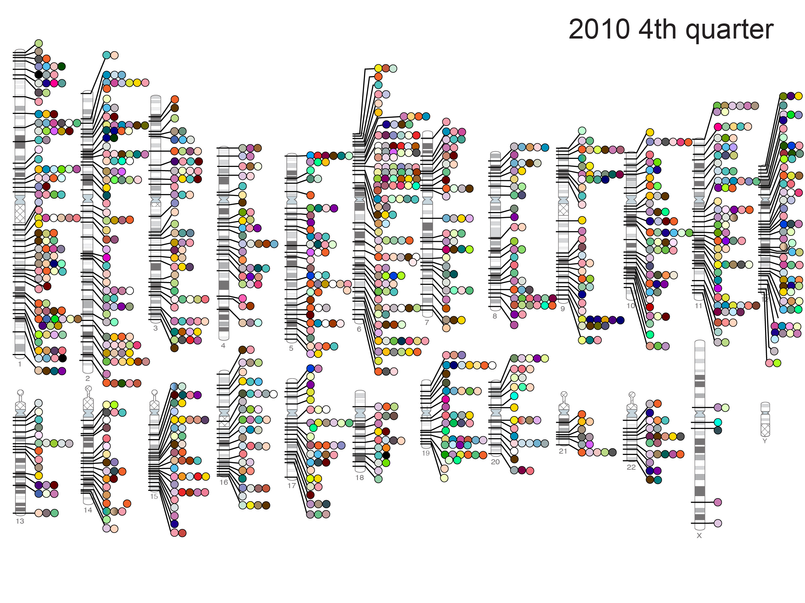
Published Genome-Wide Associations through 12/2010,
1212 published GWA at p<5x10⁻⁸ for 210 traits
NHGRI GWA Catalog
www.genome.gov/GWAStudies

Slide 33
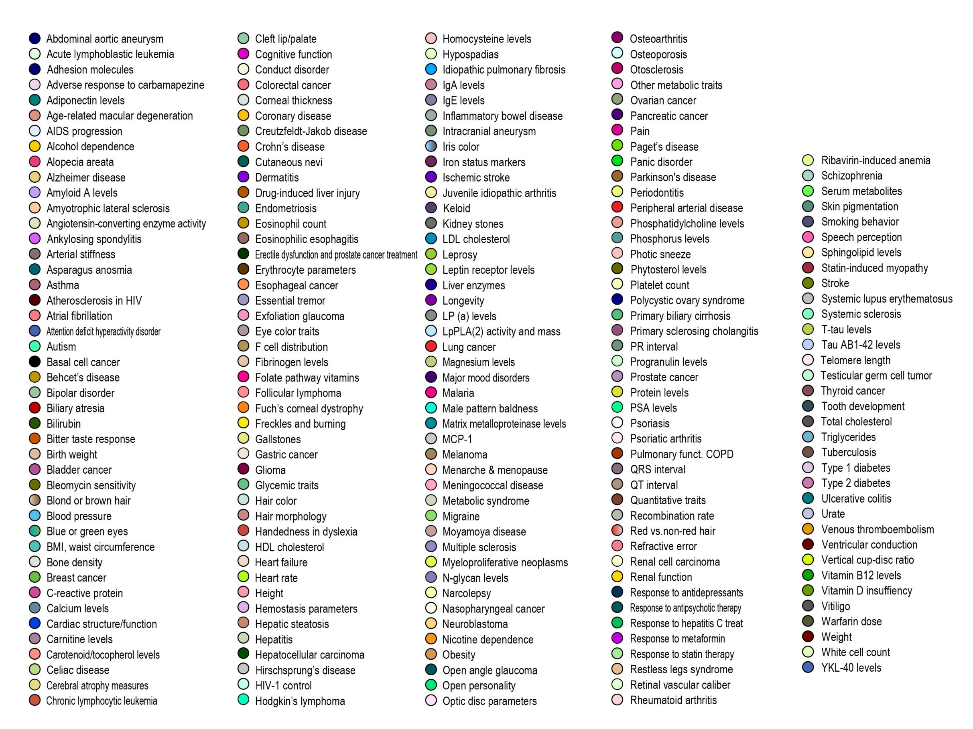

Slide 34
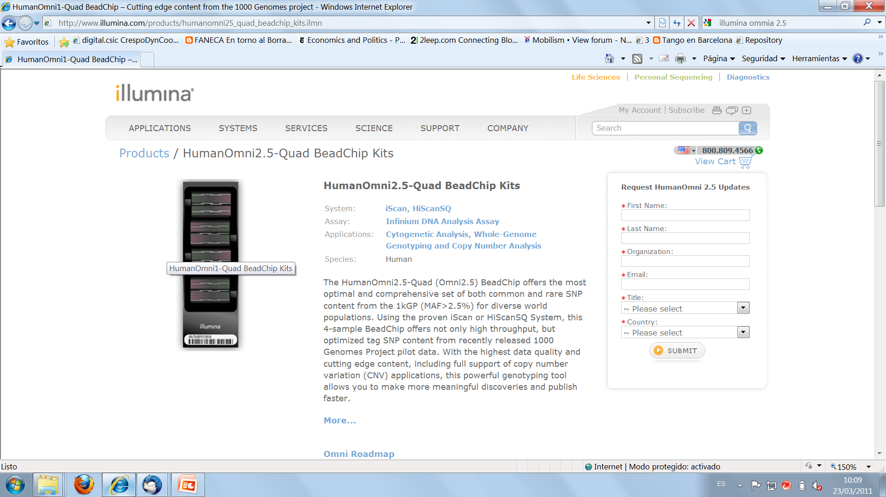
And GWAS have only begun

Slide 35
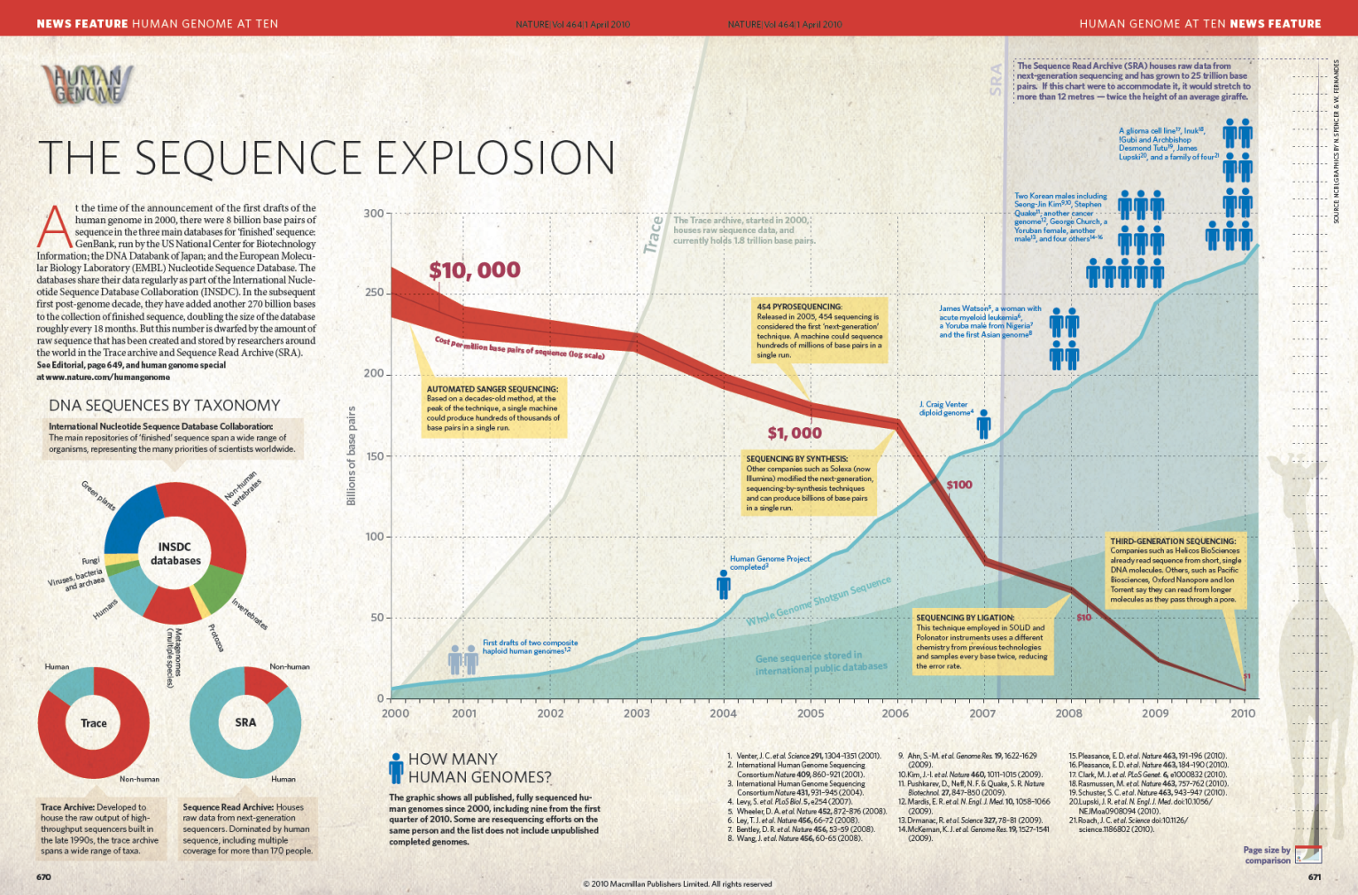
GWAS, it can only get bigger…

Slide 36


What is the problem?
People have been doing GWAS for years now with A combination of Perl scripts, Plink and R.
What do we need GWASpi for?
GWAS Hole in 1 = whishful thinking!

Slide 37
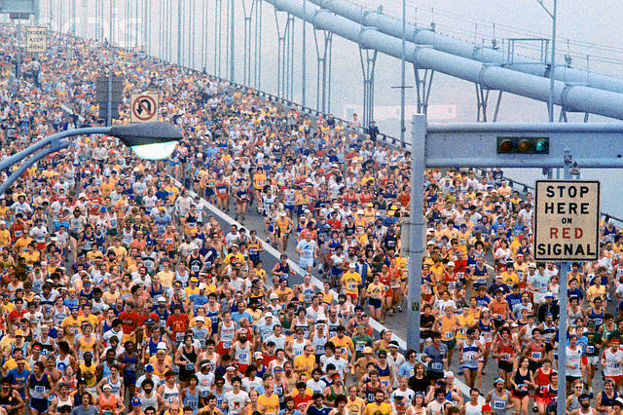

Adequate GWAS Methaphore...
The NYC Marathon wants to play minigolf...

Slide 38
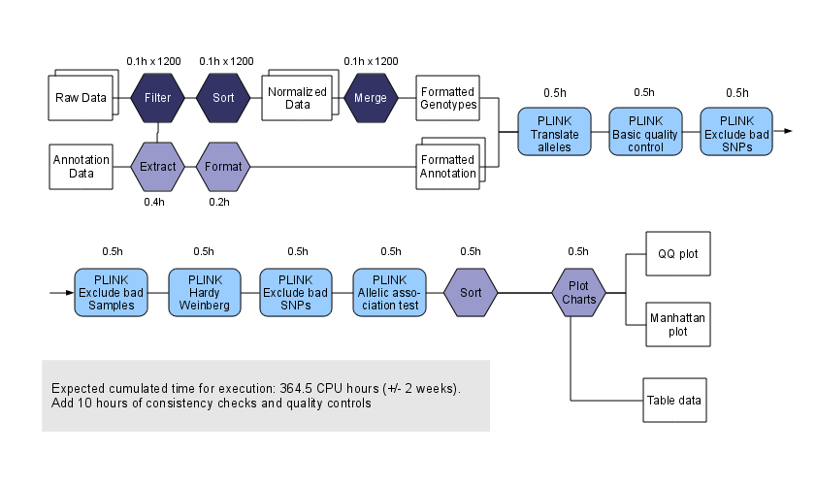
BusinessAsUsual Example of a Pipeline

Slide 39
GWAS costs
BusinessAsUsual hidden costs:
→ Bioinformatics personnel and know-how essential
→ Bottlenecks everywhere
→ Time wasted reinventing the wheel
→ Isolation and fragmentation of development efforts, scripts rarely get re-used. If re-used, require significant modifications
→ QA is so messy you need to do a QA on your QA!

Slide 40
Can you do this on a Desktop? Fast?
Some of these manipulations take days to perform
Steep learning curves: methods take time to master
Formats jungle!
Some operations gobble huge amounts of RAM and CPU → limiting factor, risk of process freeze
Parsing or RDB dependant algorithms don't scale well approaching the 10⁶ SNPs range
→ BAU process must be reassessed!

Slide 41
What data management approaches are out there?
Flat text files + scripts
Human readable BUT not efficient
Distributed processing + Map/Reduce
Good for scaling BUT added hardware and software complexity
SQL database servers + frontend clients
Widespread use BUT scaling problems
Homebrew binary formats + APIs
Scaling and speed under control BUT obscure usage
Array-Oriented Scientific Data formats
NetCDF, HDF5...

Slide 42

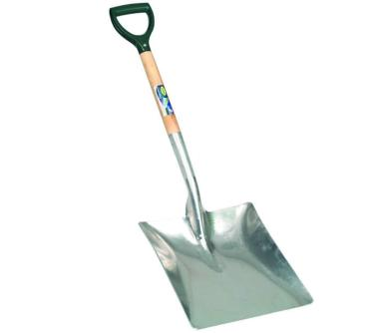
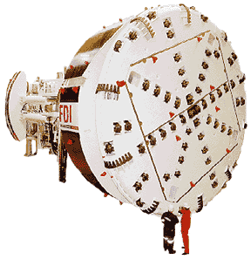
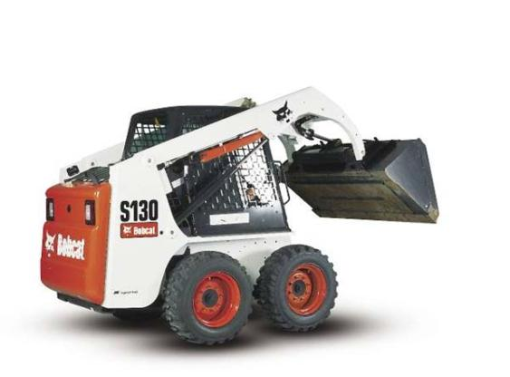
Wrong tools for our problem
What you really need is a pocket-sized bulldozer

Slide 43
Shared problems
Recurring problems in GWAS are shared among many fields in bioinformatics: logistics of data management, storage, retrieval and processing.
And, of course, all these issues are also shared by other fields, from banking to astronomy.

Slide 44
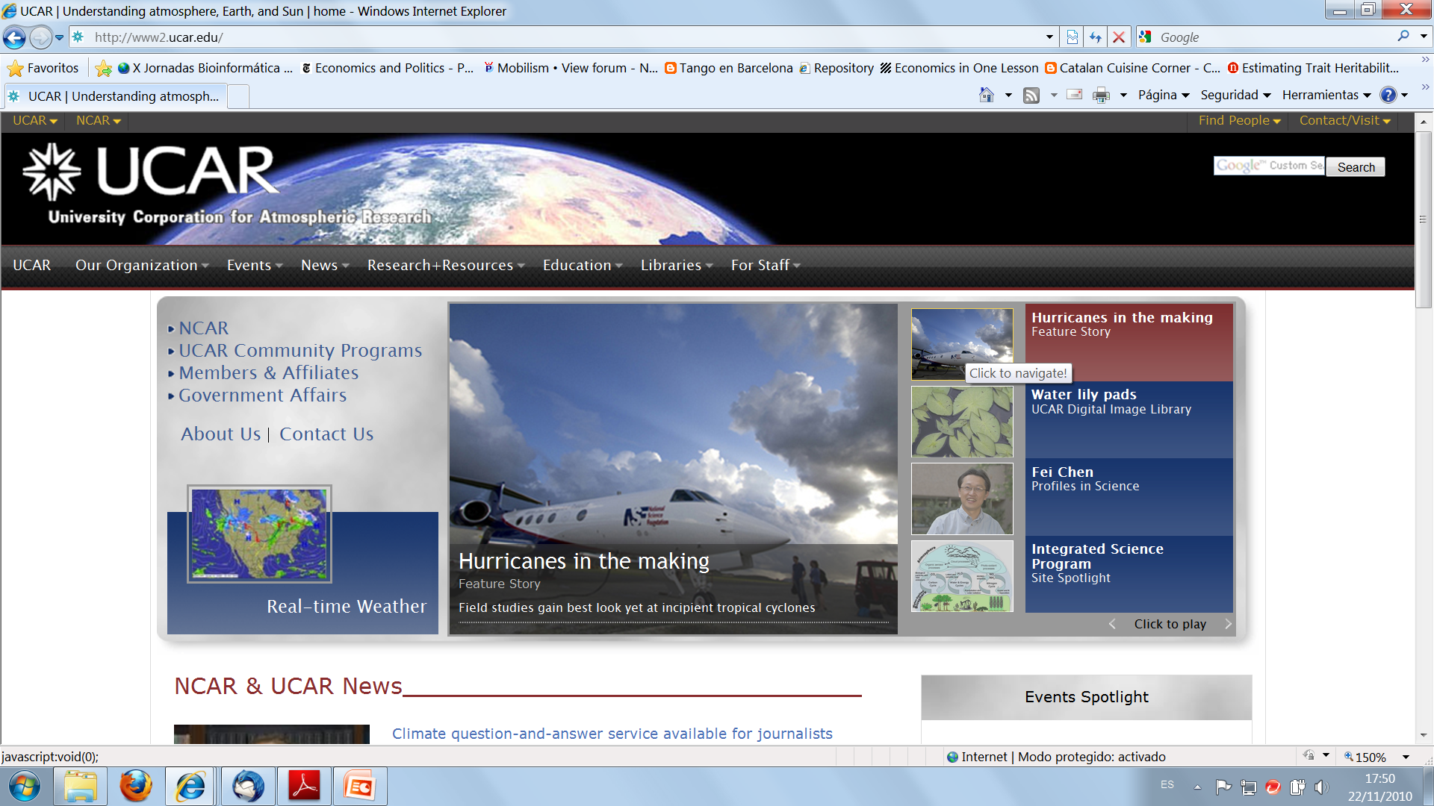
Network Common Data Form (NetCDF)

Slide 45

An Array Oriented Scientific
Data format (NetCDF)
Uses Hierarchical Data Formats (HDF5), developed by the NSCA to store and organize large amounts of numerical data.
Data is stored in matrix structures that can be retrieved directly at any point or by hyperslabs (rows, columns or combinations thereof) that are self-describing.
Speed of retrieval is independent on where inside the dataset your data is stored and what shape it has
Allows to store multidimensional objects
It scales very well and has a clear read/write methodology
It is commonly used in climatology, meteorology and GIS applications (e.g., weather forecasting, climate change) and in data storage for particle collisioners (e.g. God’s particle).

Slide 46
Array Oriented Scientific
Data formats (NetCDF)
BUT!
→ Data has to be written in one go, no editing!
(write once, read often, which is no problem in GWAS)
→ Has no auto-indexing and no SQL querying

Slide 47
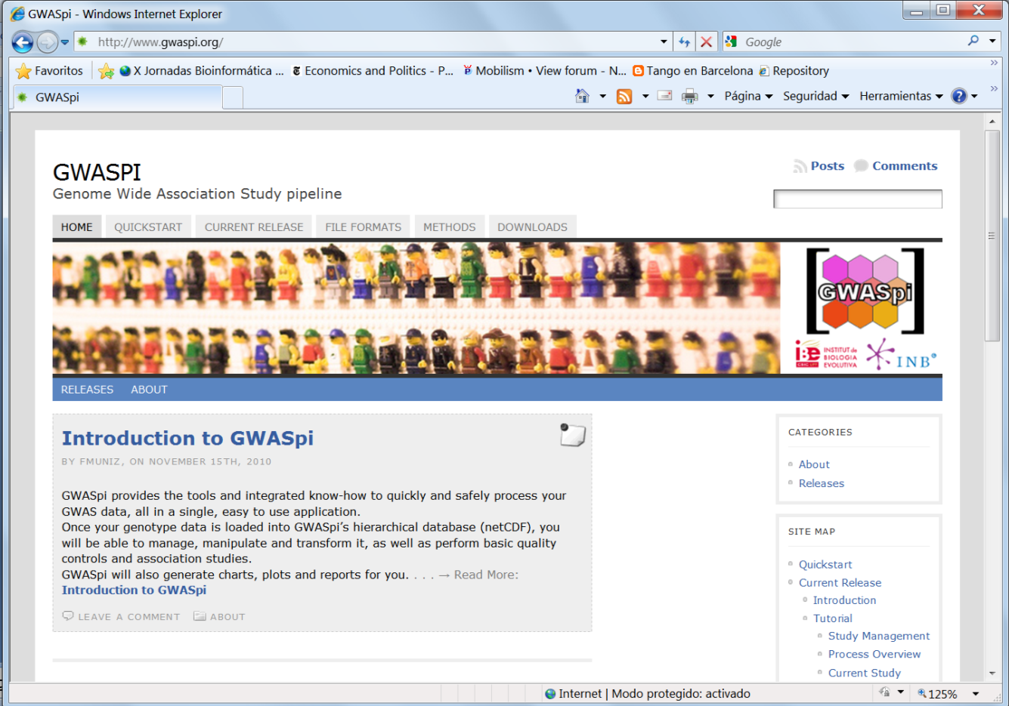
Enter GWASpi

Slide 48
Enter GWASpi
Uses Scientific Array Data Storage technology (NetCDF & HDF5).
Preprocessing, basic QC and consistency checks are done all at once.
It handles 10⁶ SNPs arrays using 1.6 GB of RAM and scales up to 10⁷ (and beyond) SNPs, just by allocating more RAM. One can easily integrate NGS data.
Disk usage scales proportionally.
Data retrieval is fast and agile. Lack of SQL queries is circumvented by building databases as indexed matrices
Imports and exports from/to most common formats and additional ones are easy to implement.

Slide 49
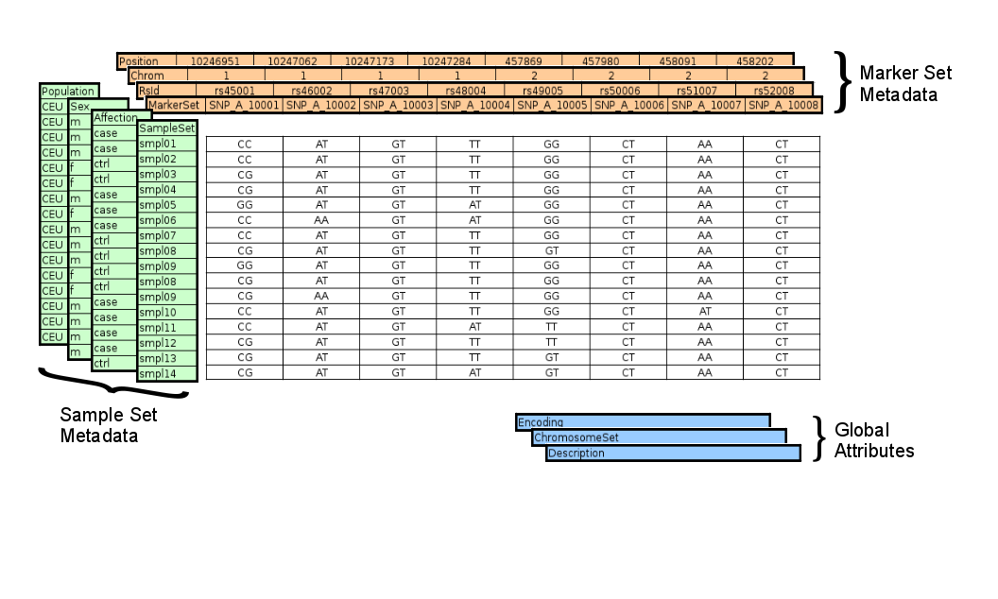
Sketch of a GWASpi NetCDF Matrix

Slide 50
GWASpi does the indexing
In GWASpi, indexing is done automatically following the standard methodology: by chromosome and physical position
Metadata is collected from annotation files
Sample data (affection, phenotypes...) can be updated easily as these are stored in an SQL database
Additional indexing can be built-in (by Interactome maps, metabolic pathway maps, gene networks....)

Slide 51
Currently accepted import formats
Import formats include, besides GWASpi’s own NetCDF format:
  PLINK
  Affymetrix GenomeWide6 export format
  Illumina (LGEN export format based on PLINK)
  BEAGLE
  HAPMAP
  HGDP supplement1
  … and growing

Slide 52
Currently available export formats
Export formats include, on top of GWASpi’s matrix files:
  PLINK
  Transposed PLINK
  BEAGLE
  MACH
  A flat-text, header and index including matrix format, for easy work with spreadsheets and Perl scripts.
The inclusion of new formats is straight-forward and more can be added per request

Slide 53
Available Quality Controls and
Analysis
GWASpi currently allows following Quality Controls
  Sample missing genotypes ratio
  SNP missing genotypes ratio
  SNP mismatch check
  Hardy-Weinberg Test
  Heterozygosity Test

Slide 54
Available Quality Controls and
Analysis
Analysis available
  Allelic Association Test
  Genotipic Association Test
  Cochran-Armitage Trend Test
  Zoomable and clickable Manhattan plots
  QQ plots
  Links results to Ensembl and NCBI databases

Slide 55
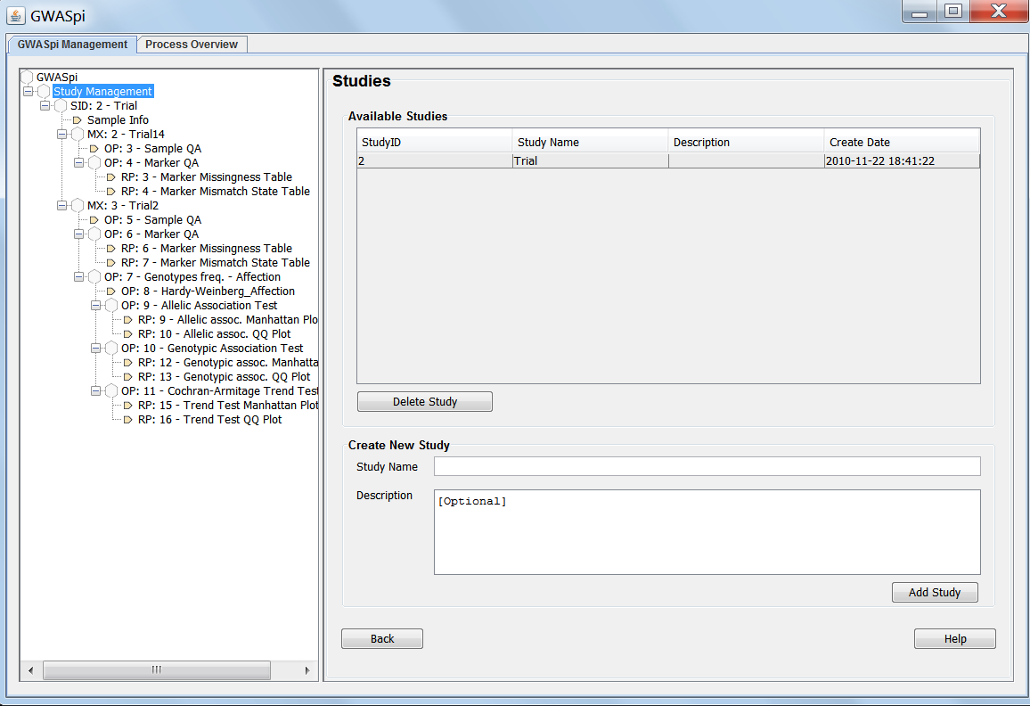
How does it look like?

Slide 56
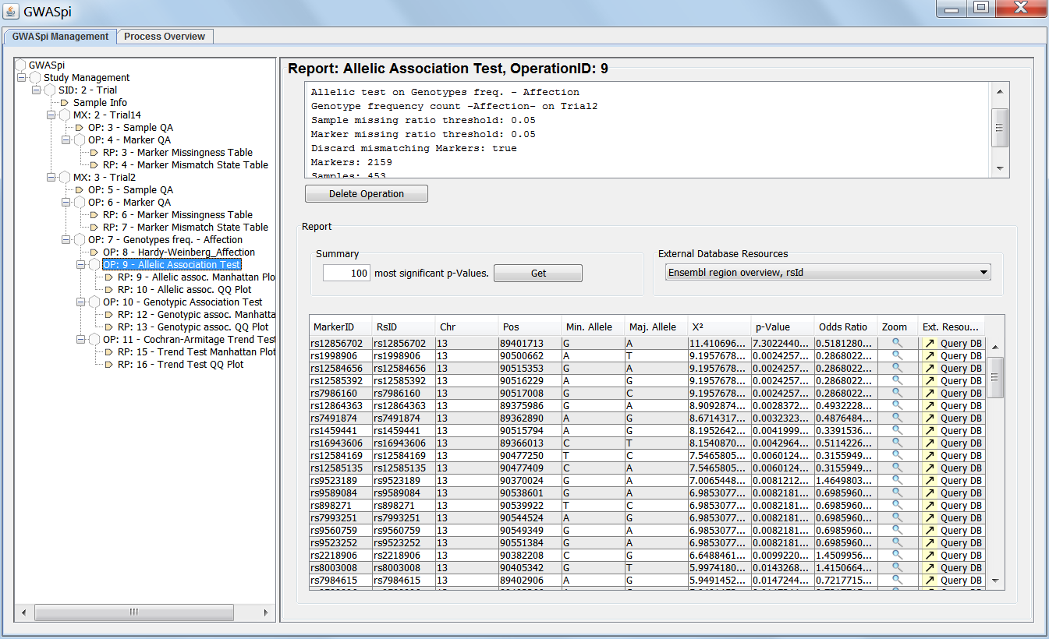
How does it look like?

Slide 57
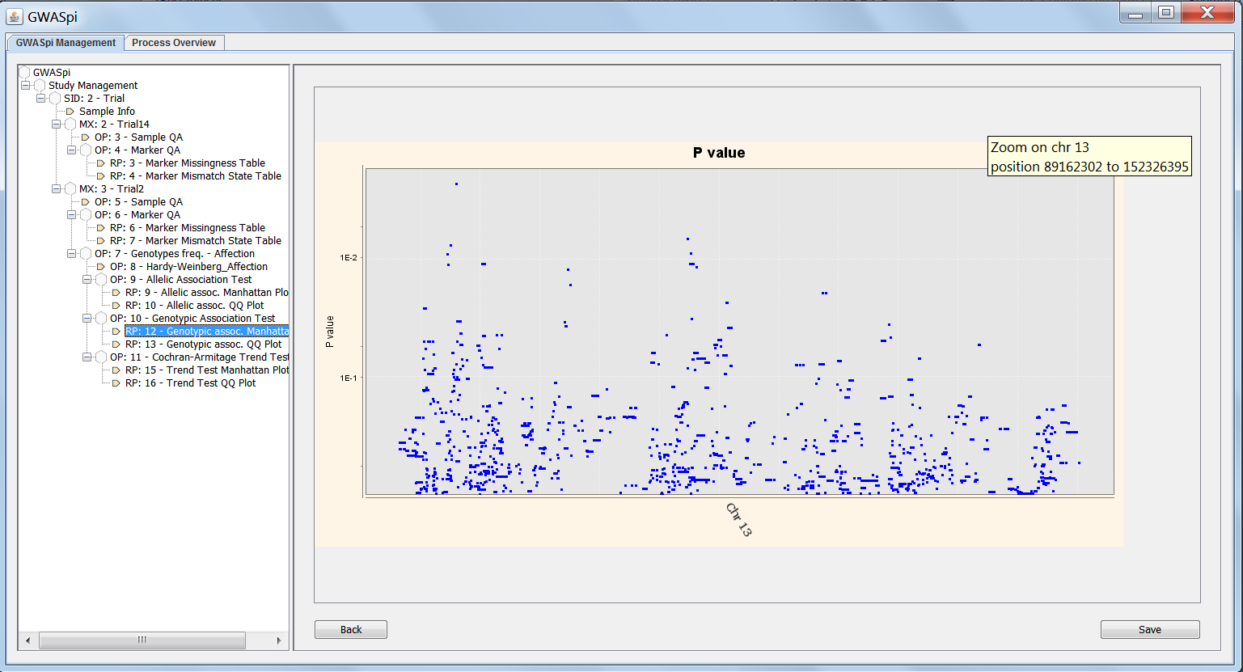
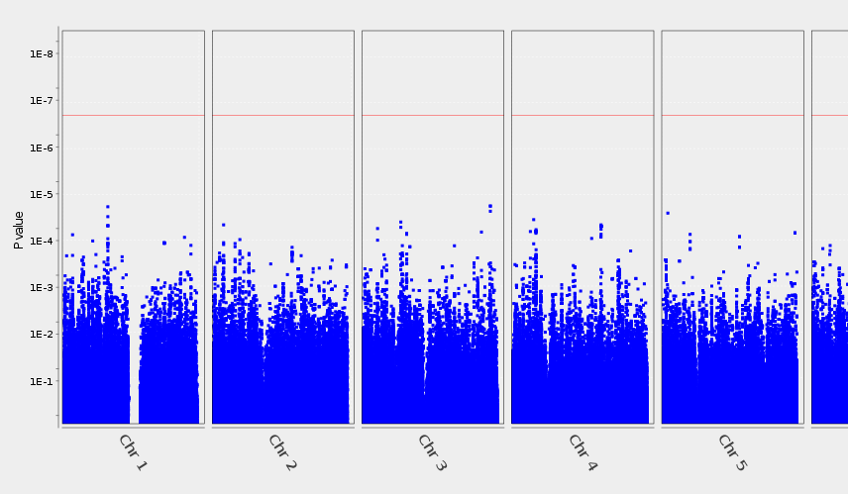
How does it look like?

Slide 58
How does it look like?

Slide 59
How fast is it? Remember BAU…

Slide 60
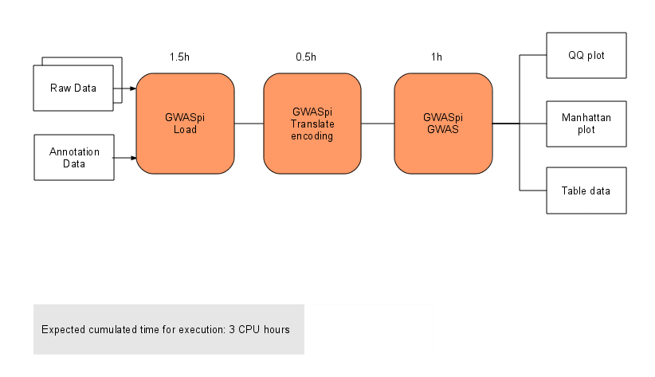
GWASpi speed comparison
Processing time is 2 orders of magnitude shorter than BAU workflow mentioned before, using identical raw data and hardware

Slide 61
How well does it fare?
It does the GWAS fast (1-12 hours, from load to graphics and tables included)
Keeps track of your data
Robust data management (extract, merge, export)
Guides the user through contextual help
Flexible and extendable, due to state-of-the-art database technology
It scales!
Has integrated reporting and charting tools
Is designed to allow for command-line and parallelization

Slide 62
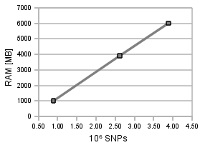
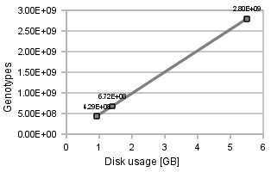
GWASpi performance
RAM usage by Nº of SNPs
Disk usage by Nº of Genotypes
Number of SNPs RAM [MB]
890.000 1000
2.610.000 3900
3.880.000 6000
A genotype matrix 2.61*10⁶ SNPs and 1053 samples large occupies 5.5GB on disk

Slide 63
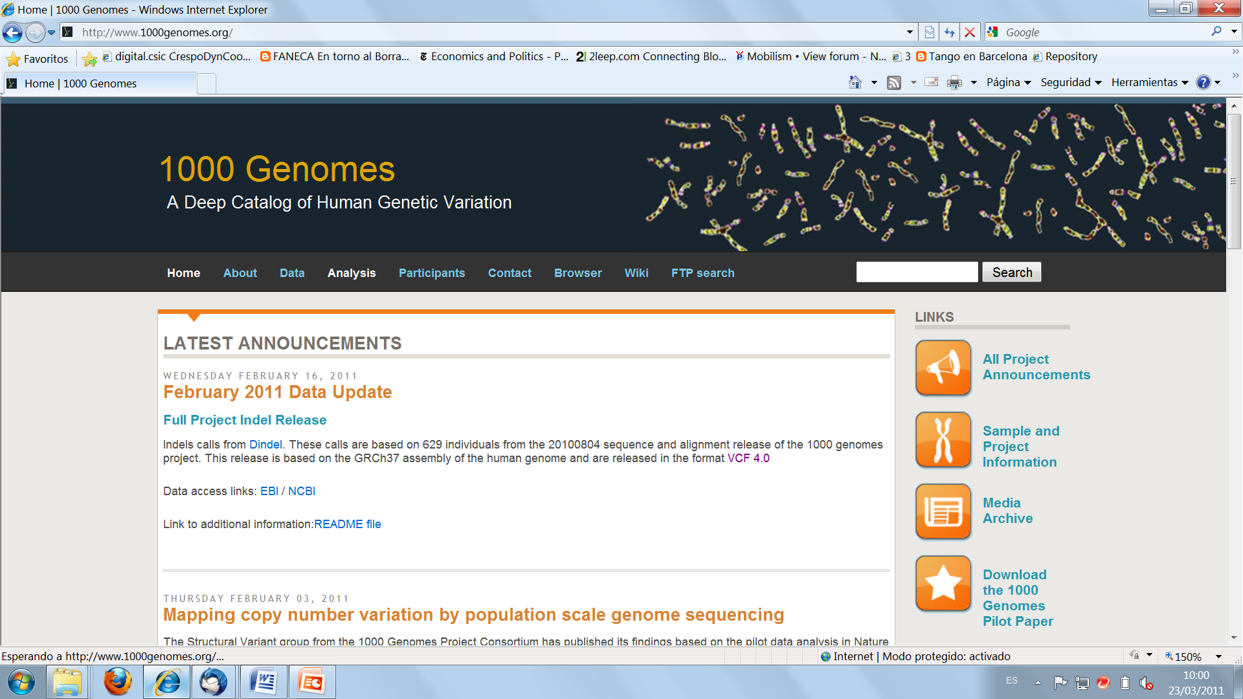
GWASpi scalability
So. If you have ultra-sequenced 1000 individuals, and called, say, 10 million heterozygous positions, you need approx. 16 Gb of RAM and 10Gb HDD. Of course you can do better with more, and of course this is easy to get…

Slide 64
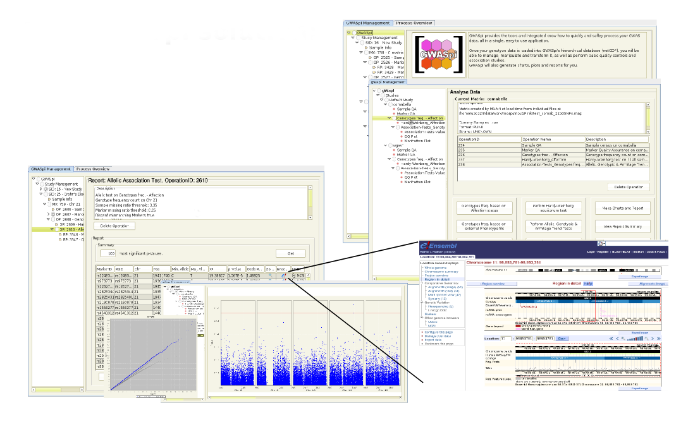
GWASpi overview (so far) www.gwaspi.org
Lets you load data from your genotyping platform and process it at the click of a button
Accepts most common formats and technologies
Can be run on any typical PC or Mac (Java)
Scalable to very large datasets keeping processing times under control
Easy to use!

Slide 65

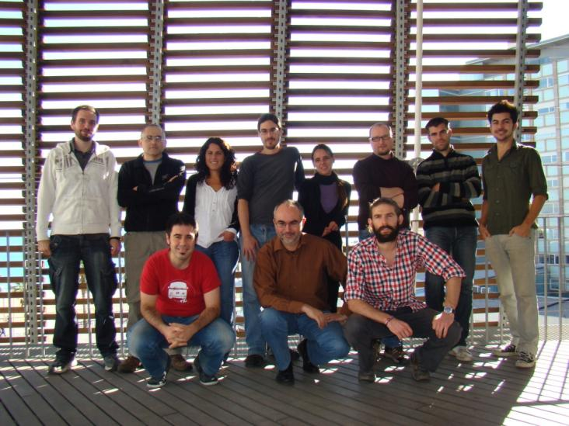



www.gwaspi.org
Thank you !
The Navarro lab…
…specially
Fernando Muñiz
Angel Carreño
Carlos Morcillo

